Slide 1


Podcast Prophet
Predict podcast rating, provide suggestions based on the podcast reviews
Ziying Feng
Notes:
Morning, I am Ziying Feng, my project is Podcast Prophet, this is a web app developed for the podcast listeners and the creators. This web app predict podcast rating and provide suggestions based on the podcast reviews.

Slide 2
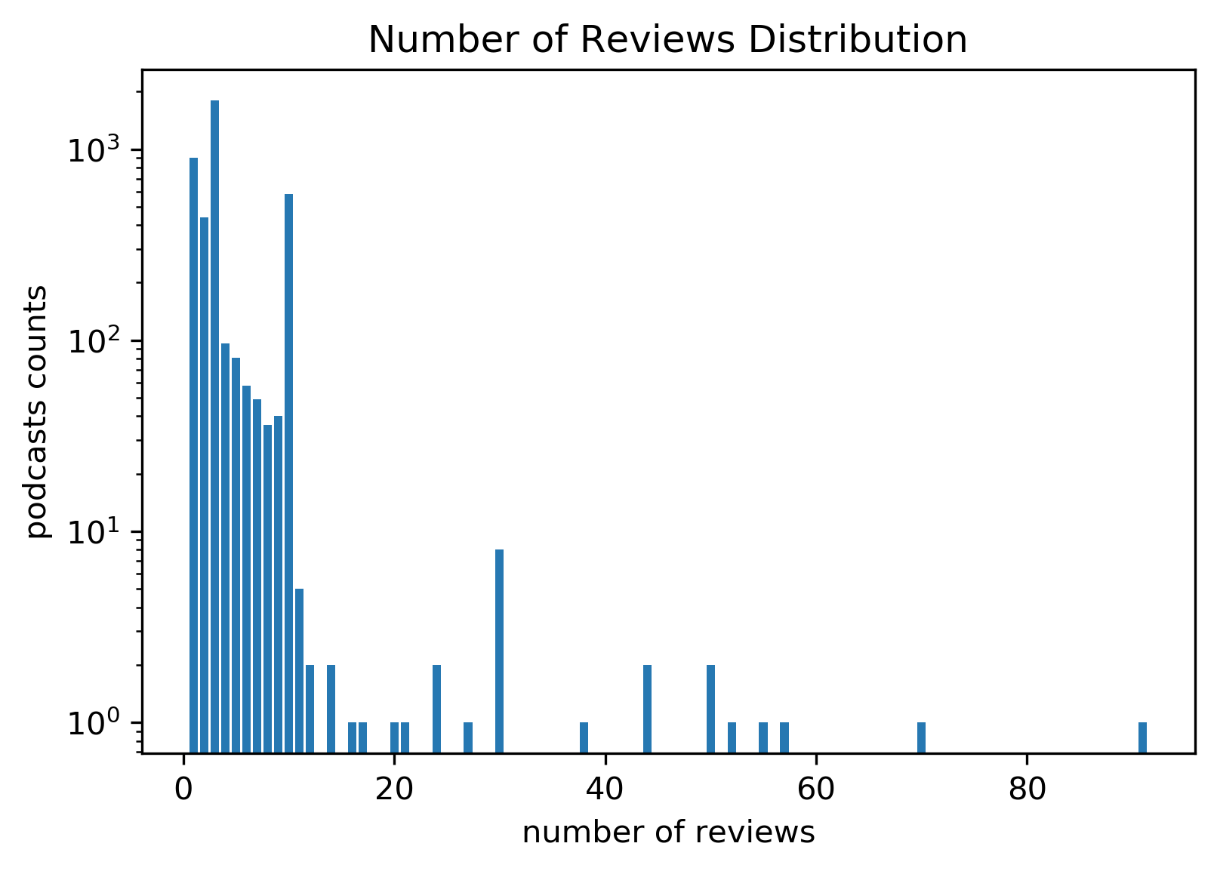
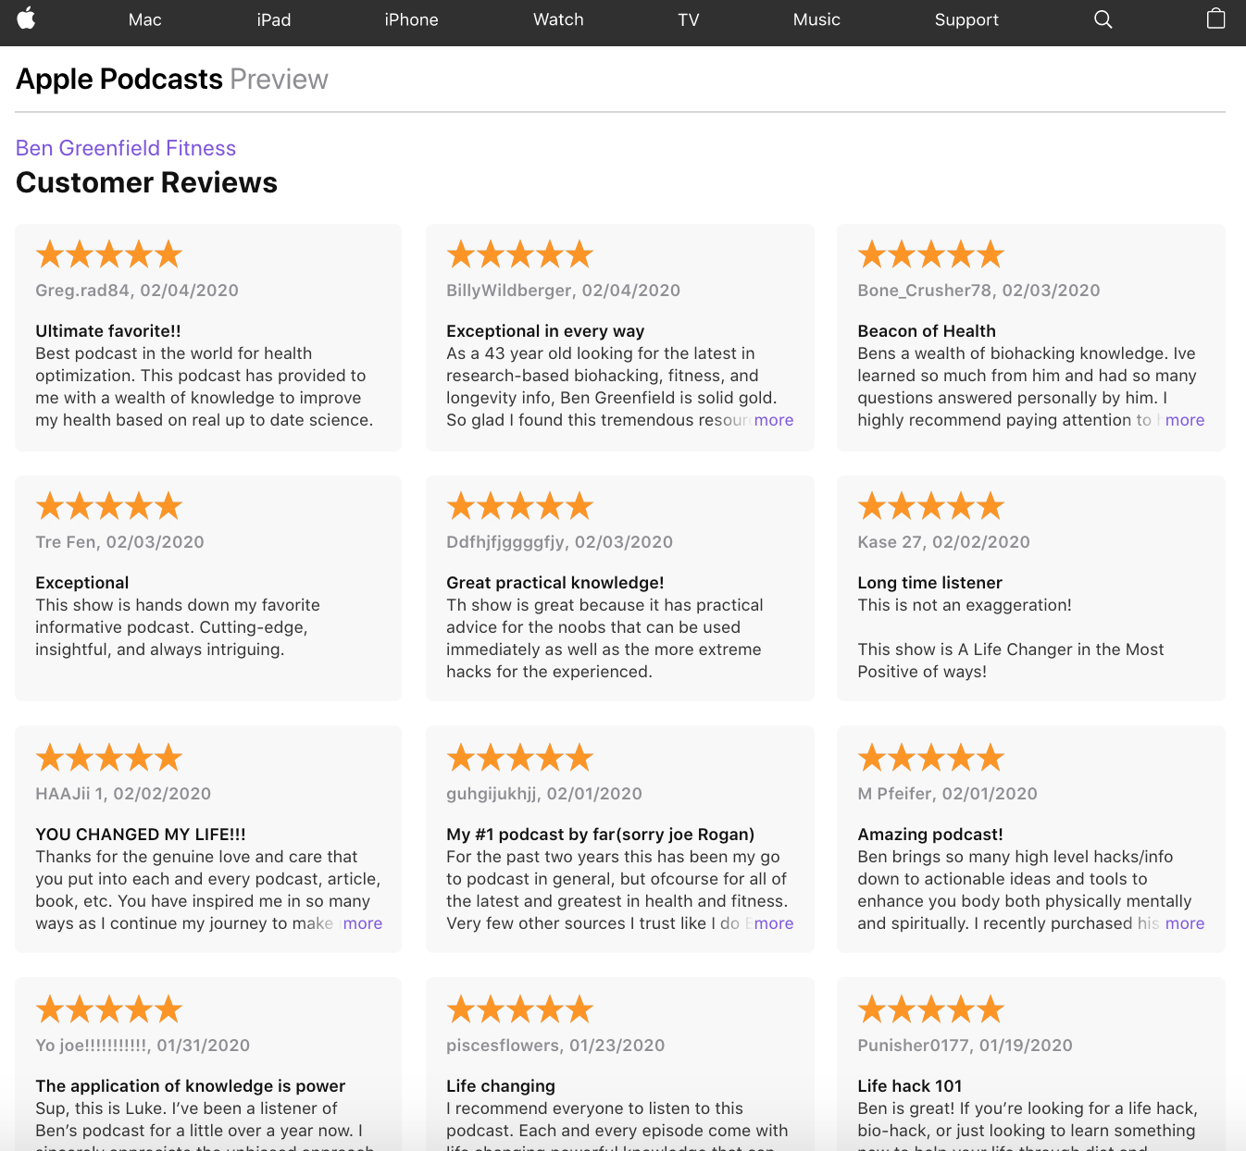
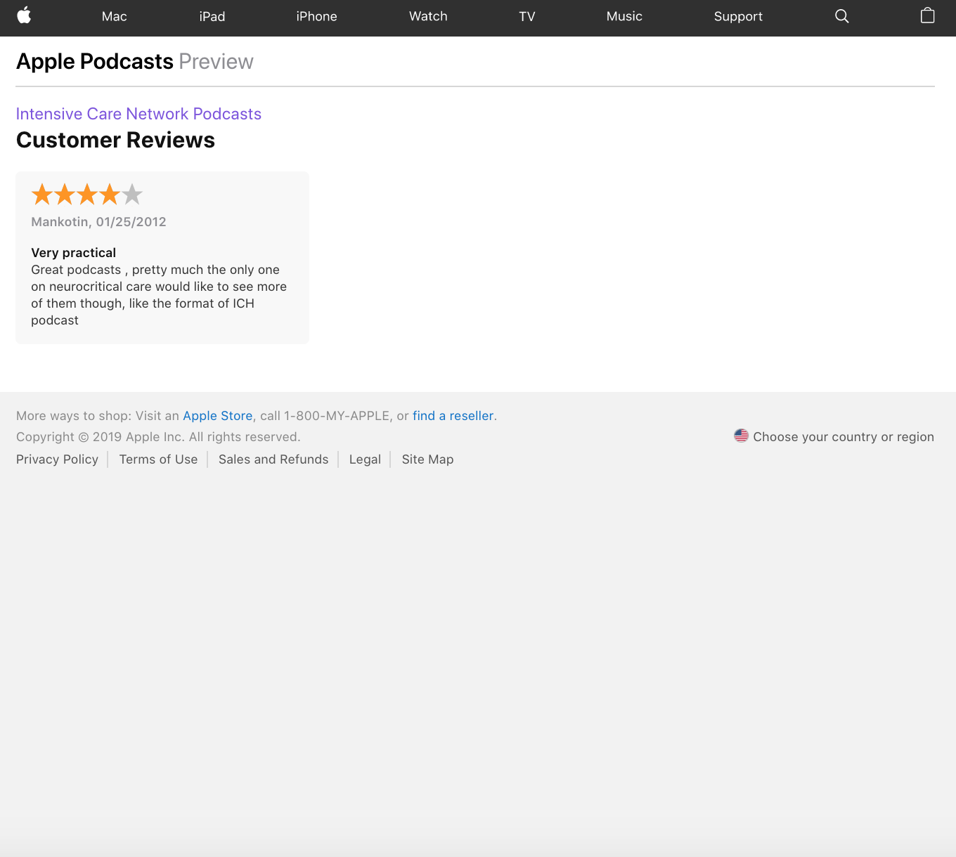
Problem
Among 10k+ fitness and health podcasts, 4115 podcasts have reviews
Listeners: if the podcast has one review, is it a good podcast to listen to?
Creators: how can I get more people to listen to my podcasts?
Predict podcast ratings and provide suggestions based on reviews
Notes:
When I listen to the podcasts on iTunes, I found out that many podcasts have few reviews. Look this is the screenshot of two podcasts, one podcast has a lot of reviews while the other has only one. Here comes the problem, If I am a podcast listener, the podcast has only one review, is it a good podcast to listen to? If I am the podcast creator, how can I get more people to listen to my podcasts? And I develop the web app called Podcast Prophet to solve these problems.

Slide 3
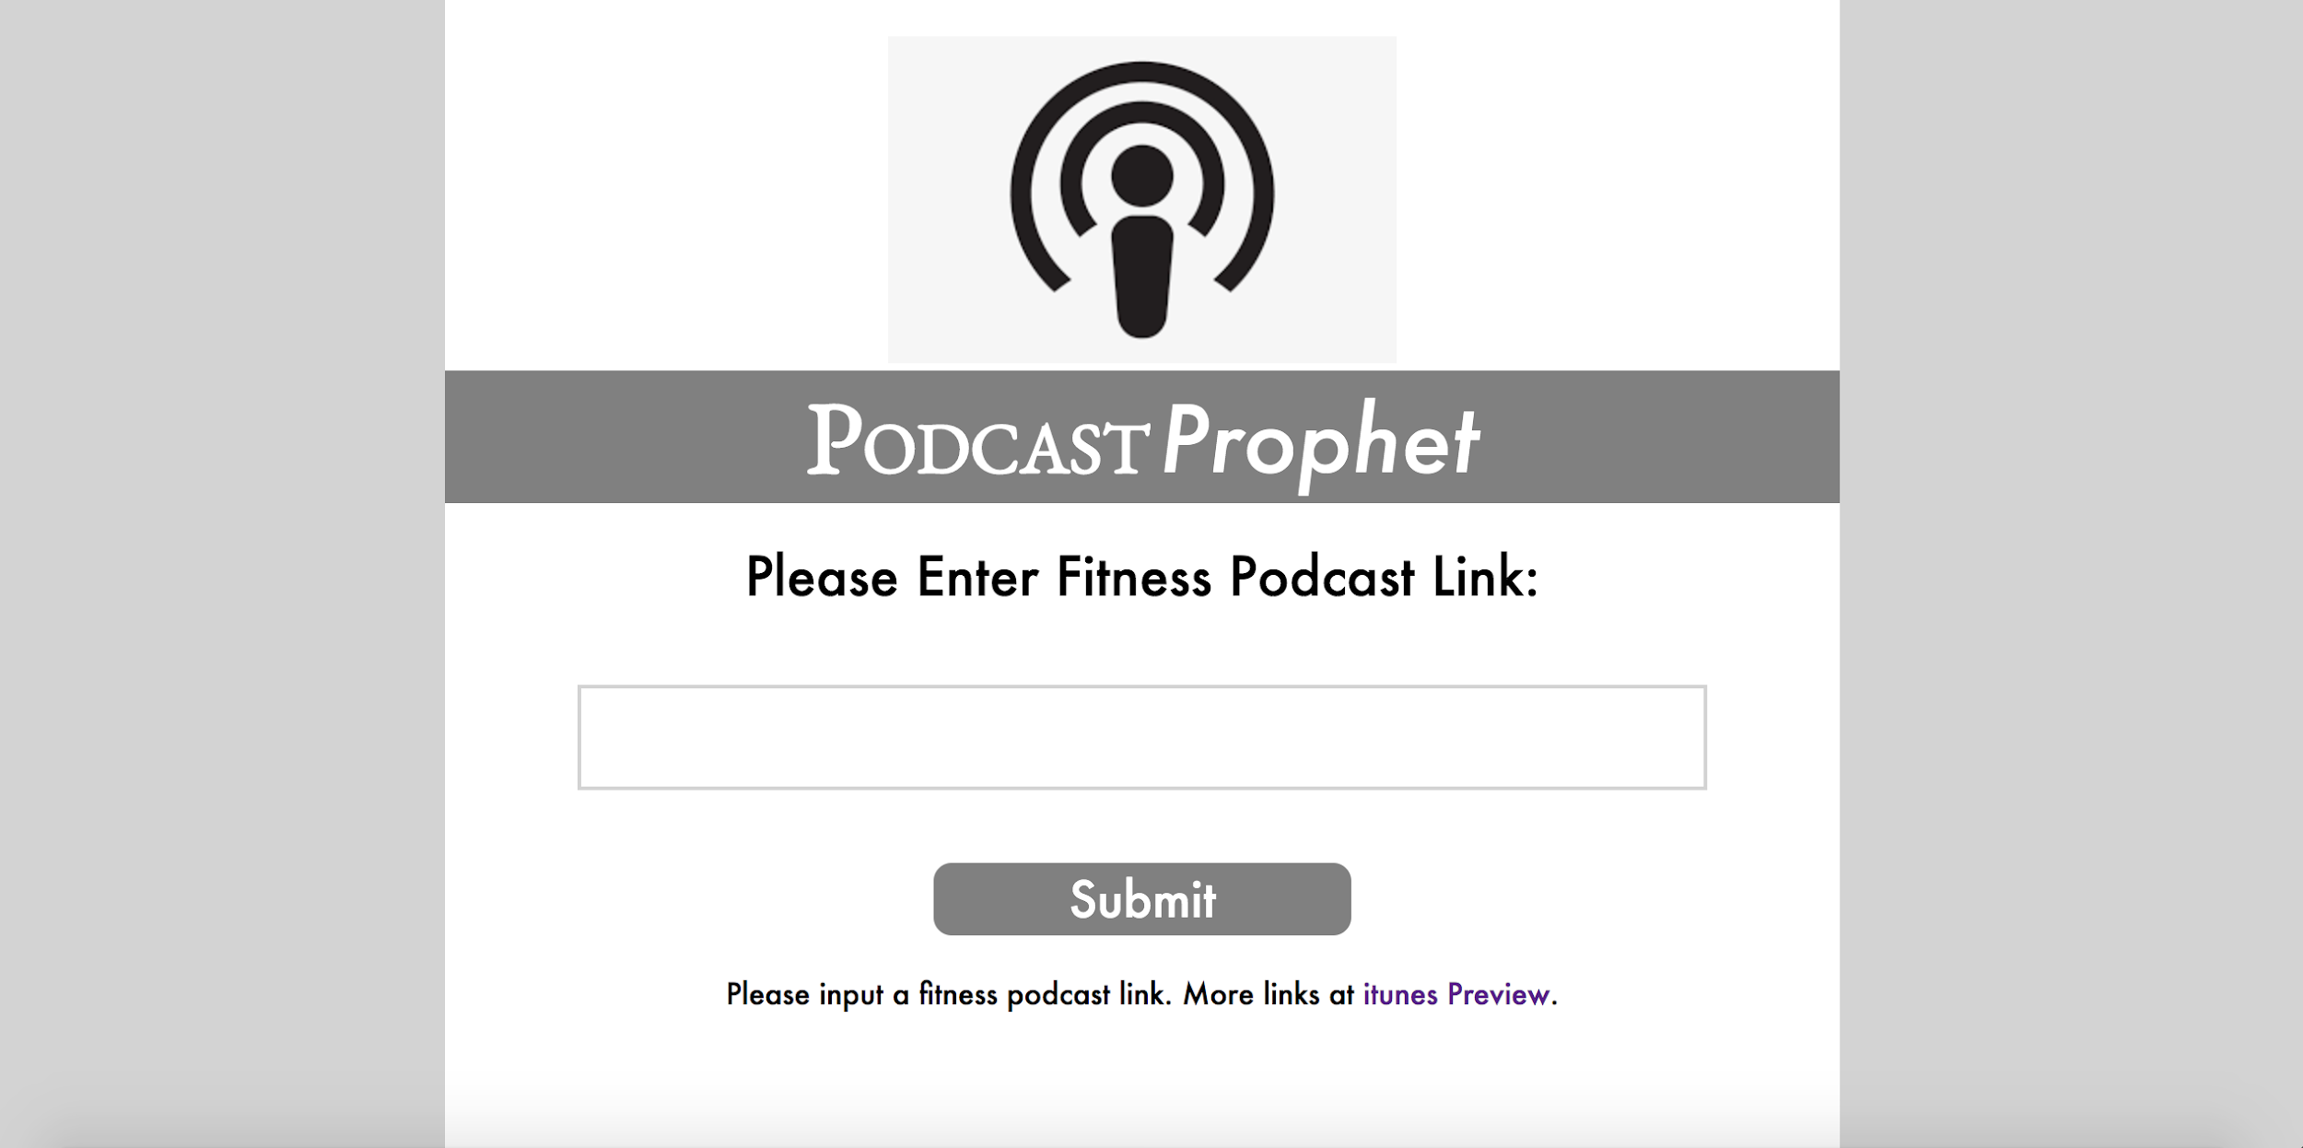
Web app
http://datascienceanalysis.xyz/
Notes:
This is my web app Podcast Prophet. To use it we need to input the pink of the podcast. Then hit submit. And it will show the predicted rating level, the sentiment analysis result, and the suggestions to the podcast based on the sentiment analysis.

Slide 4


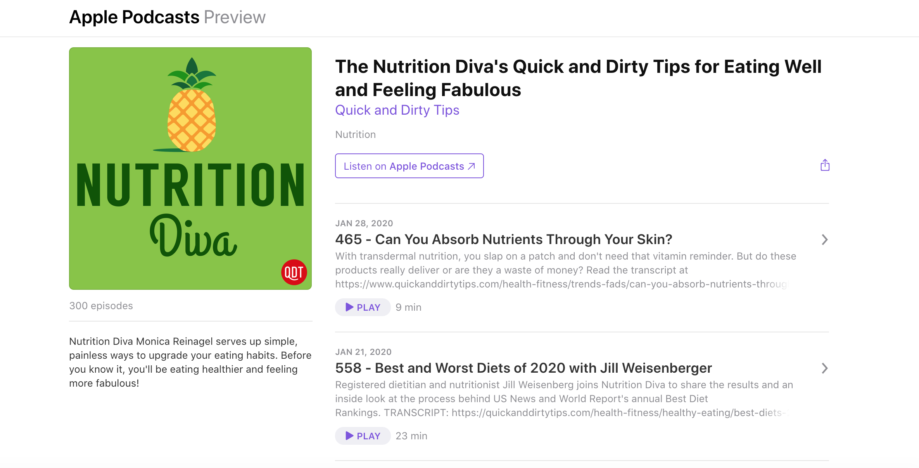
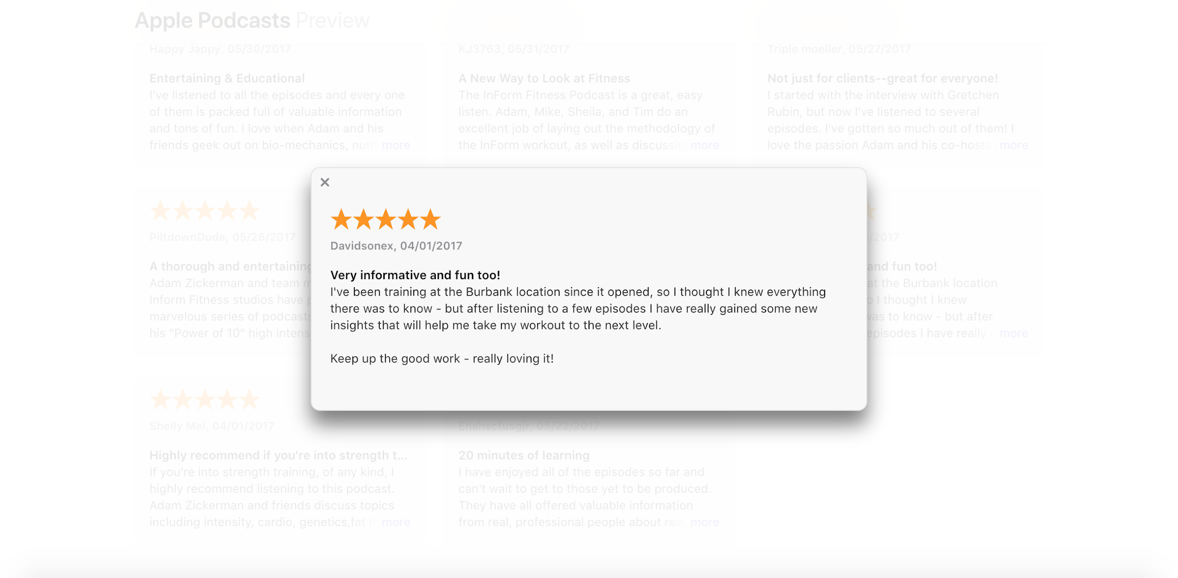
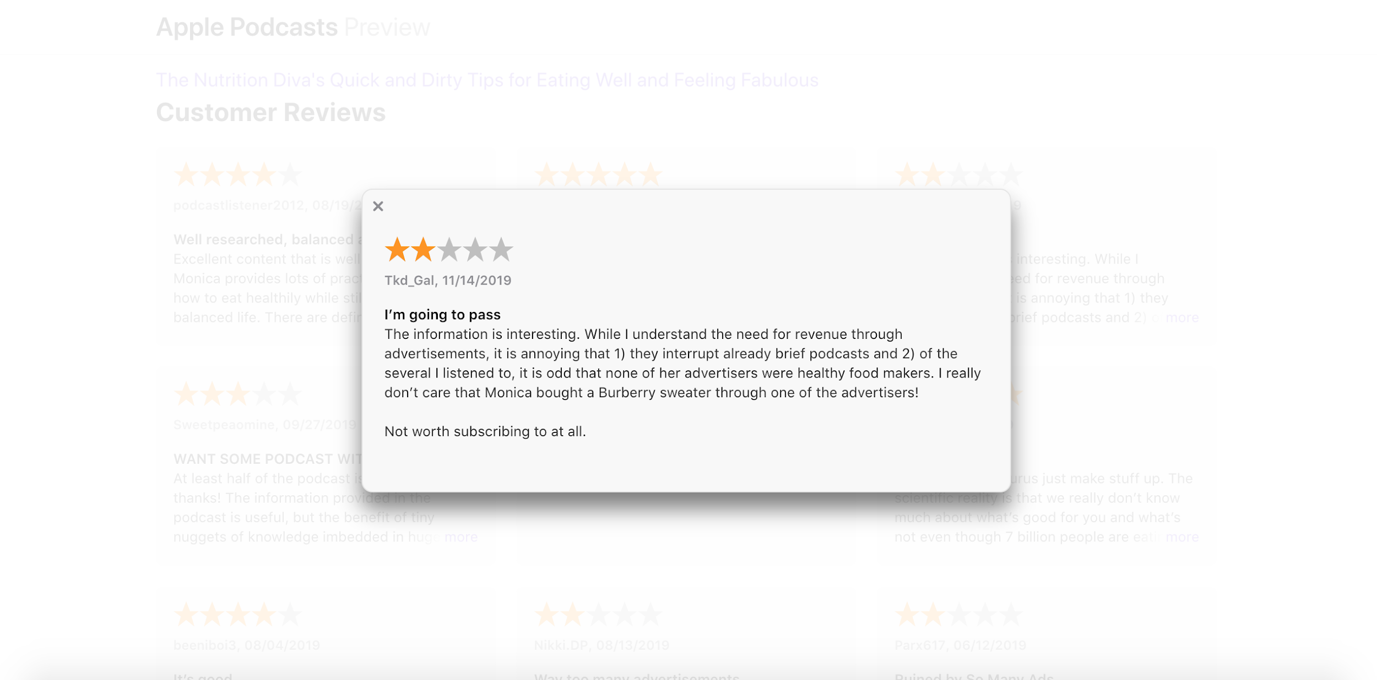
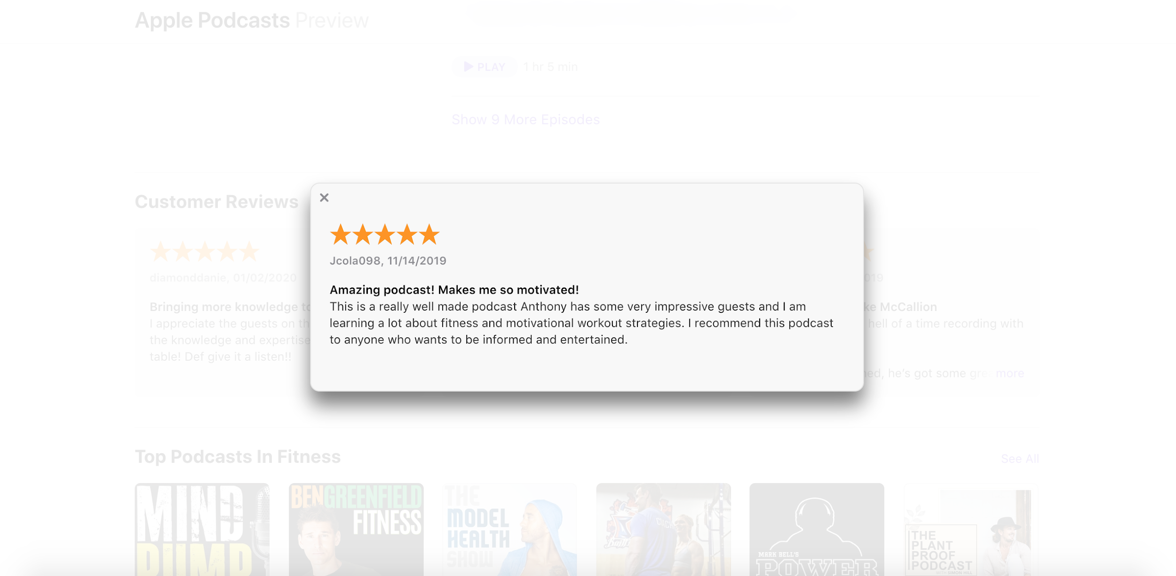
Data
Scraped 10k Fitness Podcasts from iTunes
Review Categorization
Description
Sentiment Analysis
Description Vectorization
Review
Prediction
Notes:
To develop this web app, I scraped podcasts data from iTunes, including the description and the review of the podcast.

Slide 5

Data
knowledge
data
news
intelligence
insight
......
inspiring
feeling
delight
disappoint
unhappy
......
advertisement
promotion
sponsor
product
brochure
......
audio
sound
voice
acoustic
frequency
......
Information
Emotion
Advertisement
Audio
Review Categorization
Sentiment Analysis
Cosine Similarity
"Makes me so motivated! It has a fantastic and enormous variety of sounds and speeds. Very informative and gained some new insights that will help me take my workout to the next level. But the advertisements are annoying, they interrupt already brief podcasts. "
Description Vectorization
Prediction
Notes:
Now let’s do some preprocessing to the text data. For the reviews, I split the reviews into sentences, and use the cosine similarity in Spacy to categorize each sentence in one of the four categories. The 4 categories are info, emotion, ad, audio
The Spacy documentation for vector similarity explains the basic idea of it:
Each word has a vector representation, learned by contextual embeddings (Word2Vec), which are trained on the corpora, as explained in the documentation.
VADER (Valence Aware Dictionary and sEntiment Reasoner) is a lexicon and rule-based sentiment analysis tool that is specifically attuned to sentiments expressed in social media. VADER uses a combination of A sentiment lexicon is a list of lexical features (e.g., words) which are generally labelled according to their semantic orientation as either positive or negative.

Slide 6
Data
knowledge
data
news
intelligence
insight
......
inspiring
feeling
delight
disappoint
unhappy
......
advertisement
promotion
sponsor
product
brochure
......
audio
sound
voice
acoustic
frequency
......
Information
Emotion
Advertisement
Audio
Review Categorization
Sentiment Analysis
Cosine Similarity
"Makes me so motivated! It has a fantastic and enormous variety of sounds and speeds. Very informative and gained some new insights that will help me take my workout to the next level. But the advertisements are annoying, they interrupt already brief podcasts. "
Description Vectorization
Prediction
Notes:
Here are the split sentences from the last review. For each sentence, after categorized into one of the 4 categories. I

Slide 7
Data
knowledge
data
news
intelligence
insight
......
inspiring
feeling
delight
disappoint
unhappy
......
advertisement
promotion
sponsor
product
brochure
......
audio
sound
voice
acoustic
frequency
......
Information
Emotion
Advertisement
Audio
Review Categorization
Sentiment Analysis
Cosine Similarity
"Makes me so motivated! It has a fantastic and enormous variety of sounds and speeds. Very informative and gained some new insights that will help me take my workout to the next level. But the advertisements are annoying, they interrupt already brief podcasts. "
Description Vectorization
Prediction

Slide 8
Data
knowledge
data
news
intelligence
insight
......
inspiring
feeling
delight
disappoint
unhappy
......
advertisement
promotion
sponsor
product
brochure
......
audio
sound
voice
acoustic
frequency
......
Information
Emotion
Advertisement
Audio
Review Categorization
Sentiment Analysis
Cosine Similarity
"Makes me so motivated! It has a fantastic and enormous variety of sounds and speeds. Very informative and gained some new insights that will help me take my workout to the next level. But the advertisements are annoying, they interrupt already brief podcasts. "
Description Vectorization
Prediction

Slide 9
Data
knowledge
data
news
intelligence
insight
......
inspiring
feeling
delight
disappoint
unhappy
......
advertisement
promotion
sponsor
product
brochure
......
audio
sound
voice
acoustic
frequency
......
Information
Emotion
Advertisement
Audio
Review Categorization
Sentiment Analysis
Cosine Similarity
"Makes me so motivated! It has a fantastic and enormous variety of sounds and speeds. Very informative and gained some new insights that will help me take my workout to the next level. But the advertisements are annoying, they interrupt already brief podcasts. "
Description Vectorization
Prediction

Slide 10

Data
[ Information, Emotion, Advertisement, Audio ]
Review Categorization
"Very informative and gained some new insights that will help me take my workout to the next level."
[ 1.67, Emotion, Advertisement, Audio ]
Sentiment Analysis
Description Vectorization
Prediction
Notes:
used the vaderSentiment to provide sentiment score for each sentence which forms the sentiment vector.

Slide 11
Data
[ Information, Emotion, Advertisement, Audio ]
Review Categorization
"Very informative and gained some new insights that will help me take my workout to the next level."
Sentiment Analysis
"Makes me so motivated!"
[ 1.67, 1.58, Advertisement, Audio]
Description Vectorization
Prediction

Slide 12
Data
[ Information, Emotion, Advertisement, Audio ]
Review Categorization
"Very informative and gained some new insights that will help me take my workout to the next level."
Sentiment Analysis
"Makes me so motivated!"
"But the advertisements are annoying, they interrupt already brief podcasts."
Description Vectorization
[ 1.67, 1.58, -0.70, Audio ]
Prediction

Slide 13
Data
[ Information, Emotion, Advertisement, Audio ]
Review Categorization
"Very informative and gained some new insights that will help me take my workout to the next level."
Sentiment Analysis
"Makes me so motivated!"
"But the advertisements are annoying, they interrupt already brief podcasts."
Description Vectorization
"It has a fantastic and enormous variety of sounds and speeds."
Prediction
[ 1.67, 1.58, -0.70, 0.90 ]

Slide 14
Data
Description
Review Categorization
Sentiment Analysis
TF-IDF (Term Frequency - Inverse Document Frequency) vectorize descriptions
Concatenate with the sentiment vector
Vectorization
Description TF-IDF Vector +
Review Sentiment Vector
Prediction
Notes:
The description is vectorize using TFIDF scheme, and then concatenate the description TF IDF vector with the review sentiment vector, this is the feature for my model

Slide 15
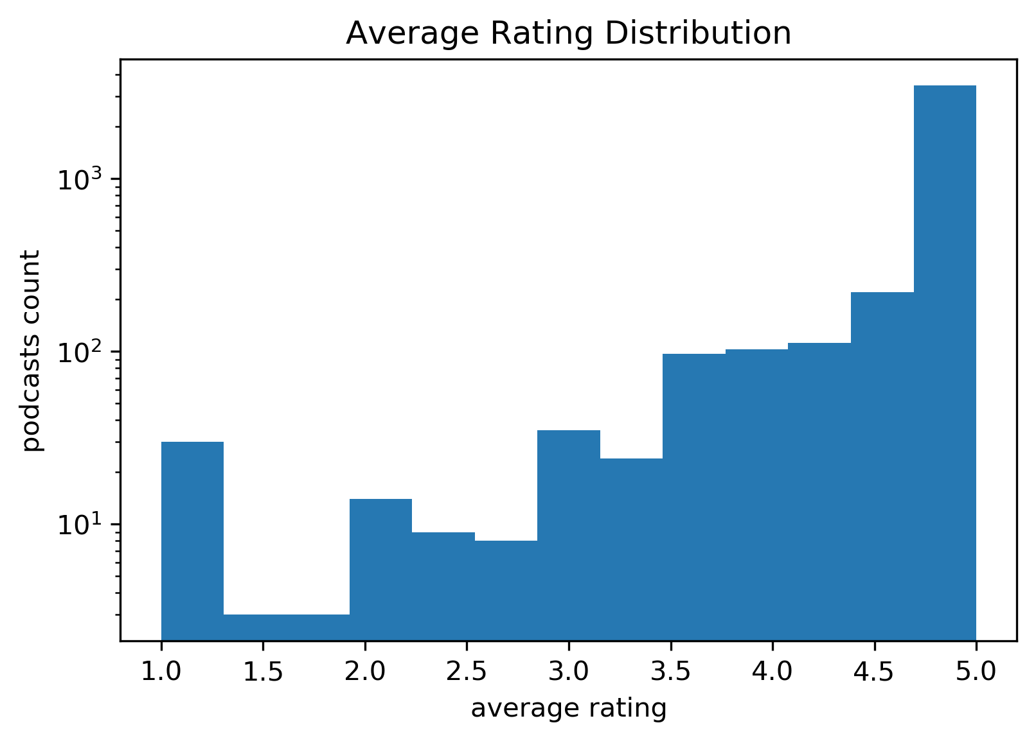
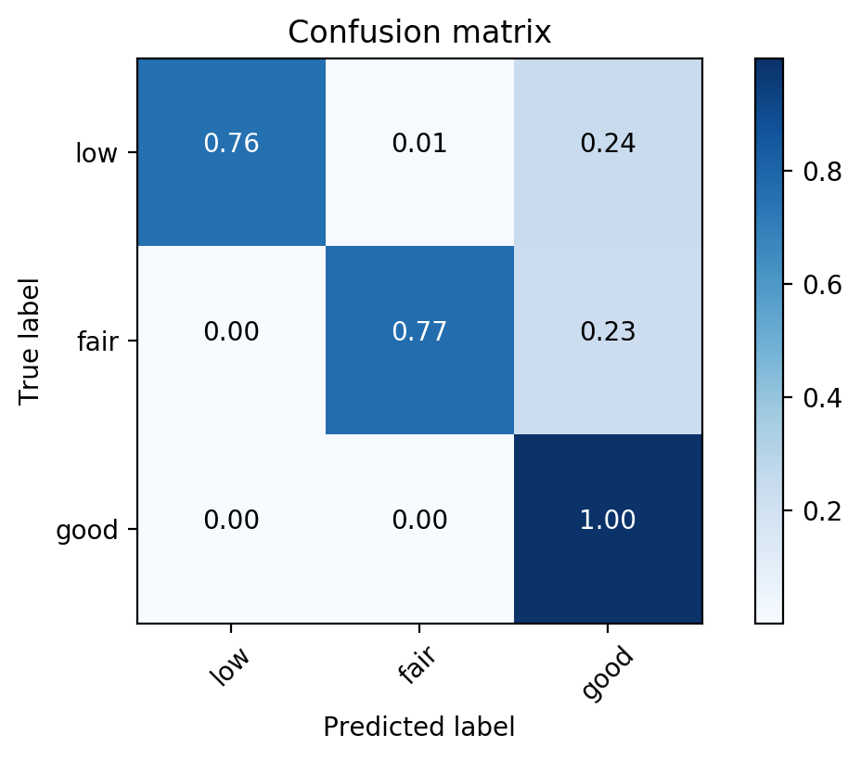
Data
Low: 0 < average_rating <= 3.5 (136 samples)
Fair: 3.5 < average_rating <= 4.8 (658 samples)
Good: 4.8 < average_rating <= 5.0 (3321 samples)
Review Categorization
Random Forest classification
Train and validate the weighted model on samples accuracy 81%
Sentiment Analysis
Vectorization
Prediction
Notes:
Next, we are gonna to train the data. Before we train the data, due to the skewed data, I recategorize the data into three rating levels low fair and good, and then used a relative fast and simple model random forest to train the data. The accuracy is 81%. From the confusion matrix, we could see that within all the three categories, over 75 % of the data are correctly labeled with the model.

Slide 16
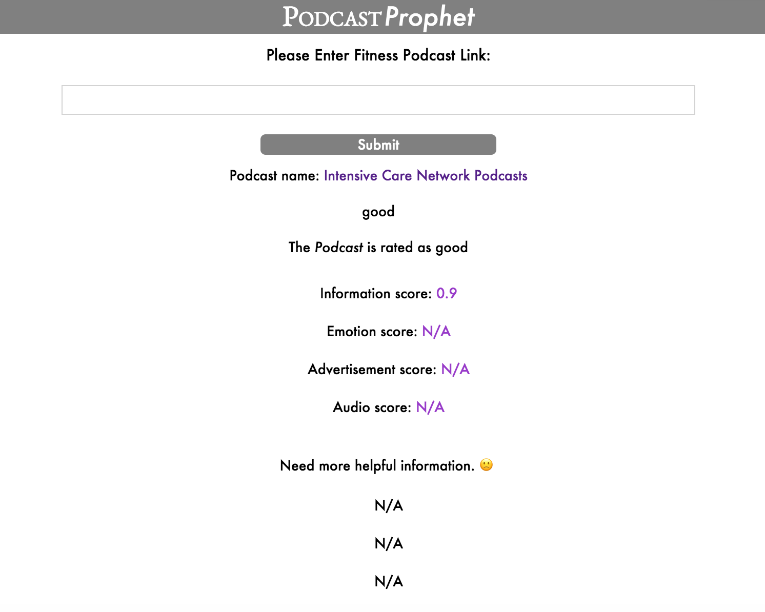

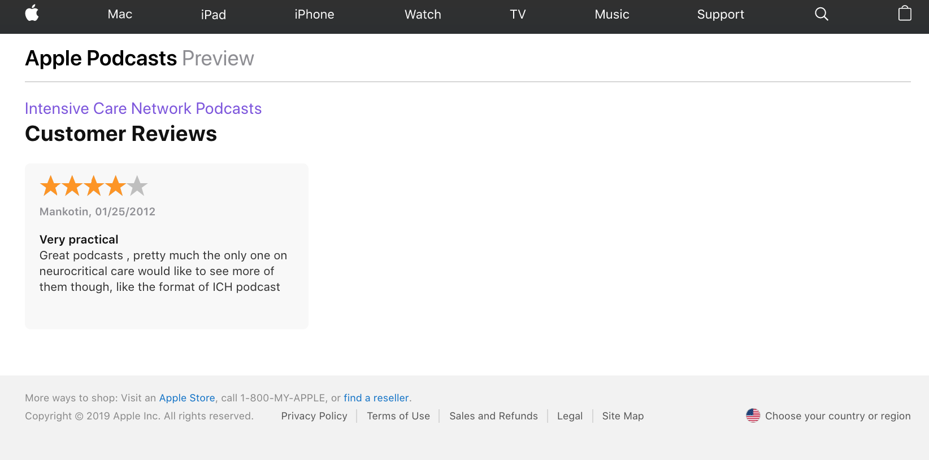
How it works?
Notes:
Now let’s go back to how my web app perform on podcast with few reviews. I used a podcast that has only one review, rating is 4 stars, and based on the description and the existing rating, my web app predicts it as good, meaning that even though this podcast has only one review, my model predicts it as worth listening to.

Slide 17



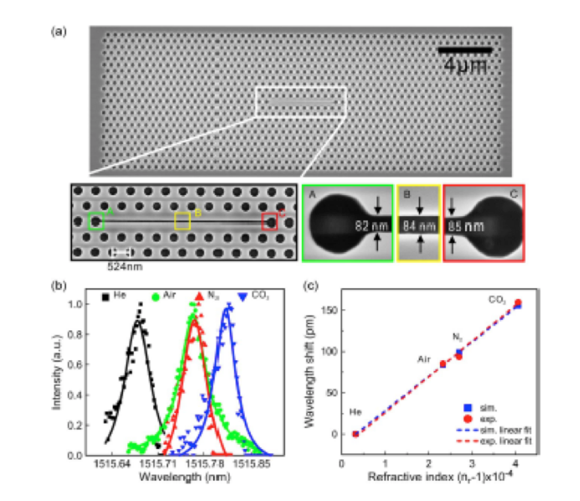
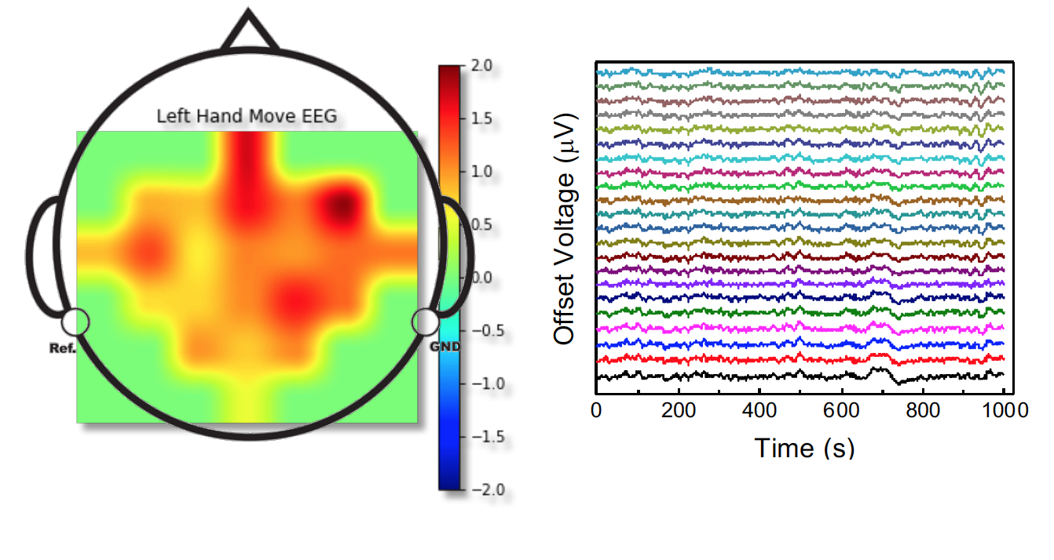
Ziying Feng
PhD, Chemistry
Notes:
I am Ziying Feng, I am a PhD in chemistry from UCLA, during my graduate study, I worked on photonic device and electronic device, I also used neural networks to do some data analysis on the electrical signal.

Slide 18
Thank you!
Notes:
Morning, I am Ziying Feng, my project is Podcast Prophet, this is a web app developed for the podcast listeners and the creators. This web app predict podcast rating and provide suggestions based on the podcast reviews.

Slide 19
Web app
http://datascienceanalysis.xyz/
Notes:
This is my web app Podcast Prophet. To use it we need to input the pink of the podcast. Then hit submit. And it will show the predicted rating level, the sentiment analysis result, and the suggestions to the podcast based on the sentiment analysis.

Slide 20
Data
"Makes me so motivated! It has a fantastic and enormous variety of sounds and speeds. Very informative and gained some new insights that will help me take my workout to the next level. But the advertisements are annoying, they interrupt already brief podcasts. "
Review Categorization
Sentiment Analysis
Description Vectorization
Review Sentiment Vector
[ Information, Emotion, Advertisement, Audio ]
Prediction
Notes:
vaderSentiment is used to form a review sentiment vector as the feature of the review

Slide 21
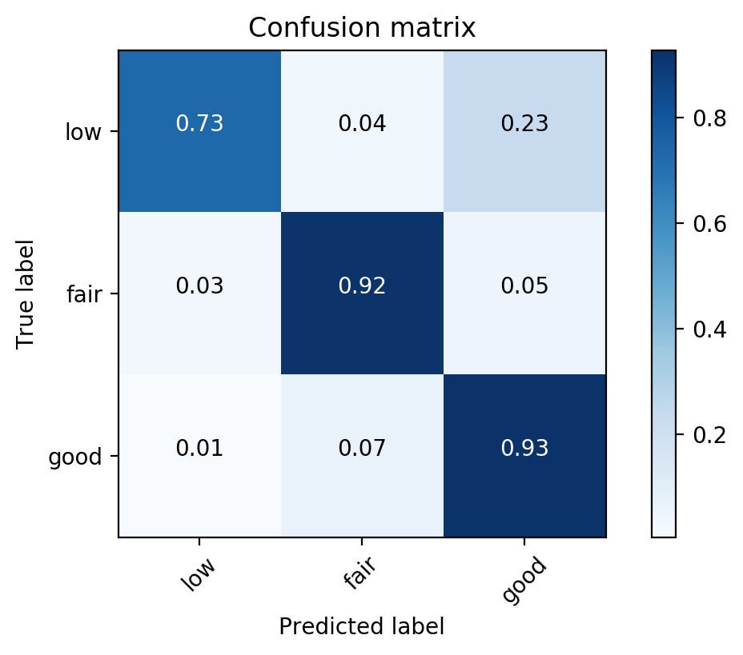
Data
Logistic Regression classification
Low: 0 < average_rating <= 3.5 (136 samples)
Fair: 3.5 < average_rating <= 4.8 (658 samples)
Good: 4.8 < average_rating <= 5.0 (3321 samples)
Train and validate the weighted model on samples that have >= 2 reviews, accuracy 98%
Review Categorization
Sentiment Analysis
Vectorization
Prediction
Notes:
Due to the skewed data, we used weighted mode of the svm model, it will automatically adjust weights inversely proportional to class frequencies in the input data
The rates that correctly predicted are all higher than 80%
Go back to the 2nd slide, How about the accuracy of the samples with few reviews < 20 reviews, how about the accuracy of the samples with more reviews

Slide 22
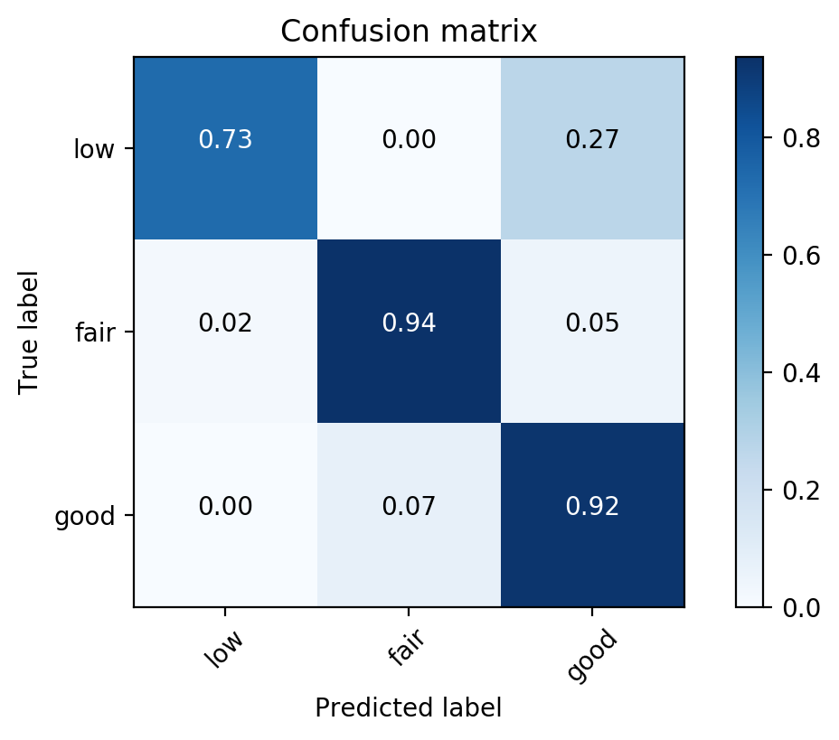
Data
SVM classification
Low: 0 < average_rating <= 3.5 (136 samples)
Fair: 3.5 < average_rating <= 4.8 (658 samples)
Good: 4.8 < average_rating <= 5.0 (3321 samples)
Review Categorization
Train and validate the weighted model on samples that have >=2 reviews, accuracy 91%
Sentiment Analysis
Vectorization
Prediction
Notes:
Due to the skewed data, I recategorize the data into three groups that is low fair and good
then the features are fed into the SVM model. The accuracy of this is 76%, and the confusion matrix shows that over 80% of the samples from each of the category are correctly predicted.
animate
of the three categories, we used weighted mode of the svm model, it will automatically adjust weights inversely proportional to class frequencies in the input data
fair rating podcast have high potential
The rates that correctly predicted are all higher than 80%
one for the pipeline
what model, features, performance
Go back to the 2nd slide, How about the accuracy of the samples with few reviews < 20 reviews, how about the accuracy of the samples with more reviews

Slide 23
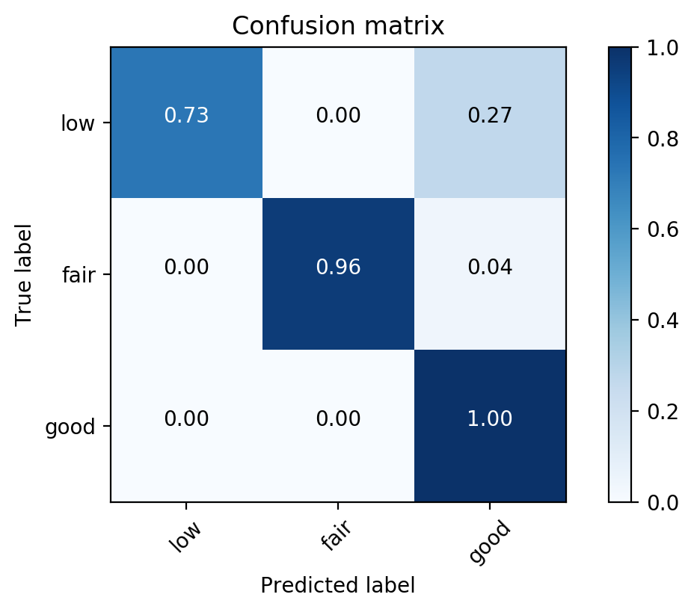
Data
Random Forest classification
Low: 0 < average_rating <= 3.5 (136 samples)
Fair: 3.5 < average_rating <= 4.8 (658 samples)
Good: 4.8 < average_rating <= 5.0 (3321 samples)
Train and validate the weighted model on samples that have >= 2 reviews, accuracy 98%
Review Categorization
Sentiment Analysis
Vectorization
Prediction
Notes:
Due to the skewed data, we used weighted mode of the svm model, it will automatically adjust weights inversely proportional to class frequencies in the input data
The rates that correctly predicted are all higher than 80%
Go back to the 2nd slide, How about the accuracy of the samples with few reviews < 20 reviews, how about the accuracy of the samples with more reviews

Slide 24
Data
Logistic Regression vs SVM
Review Categorization
Sentiment Analysis
Vectorization
Prediction
Notes:
Go back to the problem, most examples have few reviews, To prove this model works for samples with few reviews

Slide 25
Data
Logistic Regression vs SVM
Review Categorization
Logistic Regression
SVM
Sentiment Analysis
Vectorization
Prediction
Notes:
Go back to the problem, most examples have few reviews, To prove this model works for samples with few reviews
SVM better, SVM better for high dimension, more features

Slide 26
Data
Random Forest classification
Low: 0 < average_rating <= 3.5 (136 samples)
Fair: 3.5 < average_rating <= 4.8 (658 samples)
Good: 4.8 < average_rating <= 5.0 (3321 samples)
Train and validate the weighted model on samples that have >= 2 reviews, accuracy 98%
Review Categorization
Sentiment Analysis
Vectorization
Prediction
Notes:
Due to the skewed data, we used weighted mode of the svm model, it will automatically adjust weights inversely proportional to class frequencies in the input data
The rates that correctly predicted are all higher than 80%
Go back to the 2nd slide, How about the accuracy of the samples with few reviews < 20 reviews, how about the accuracy of the samples with more reviews

Slide 27
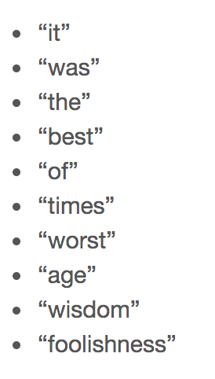
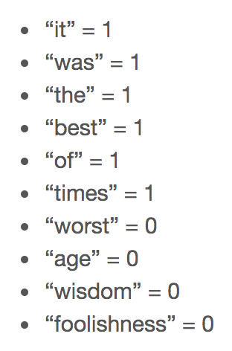
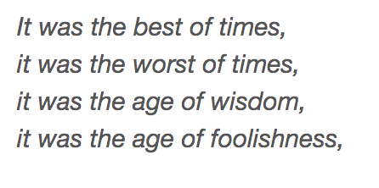
Bag of Words
Unique words:
Doc1:
[1, 1, 1, 1, 1, 1, 0, 0, 0, 0]
Doc1:
Doc2:
Doc3:
Doc4:

Slide 28
TF-IDF
Term Frequency Inverse Document Frequency
evaluate how important a word is to a document in a collection or corpus.
TF = Term Frequency, measures how frequently a term occurs in a document.
IDF = Inverse Document Frequency, measures how important a term is.

Slide 29
TF-IDF
TF = Term Frequency
measures how frequently a term occurs in a document.
TF(t) = (Number of times term t appears in a document) / (Total number of terms in the document)
5/15
IDF = Inverse Document Frequency
measures how important a term is.
IDF(t) = log_e(Total number of documents / Number of documents with term t in it)
log(4/2)
TF-IDF = 5/15*log(4/2)
Doc1
Cat ... cat...............
.......cat........cat......
..............................
.........cat.................
Corpus
Doc1
Doc2
Doc3
Doc4
Cat ... cat...............
.......cat........cat......
..............................
.........cat.................
..............................
..............................
..............................
..............................
..............................
..............................
..............................
..............................
..............................
.......cat..................
..............................
...............................
Notes:
Since every document is different in length, it is possible that a term would appear much more times in long documents than shorter ones. Thus, the term frequency is often divided by the document length (aka. the total number of terms in the document) as a way of normalization
However it is known that certain terms, such as "is", "of", and "that", may appear a lot of times but have little importance. Thus we need to weigh down the frequent terms while scale up the rare ones,

Slide 30
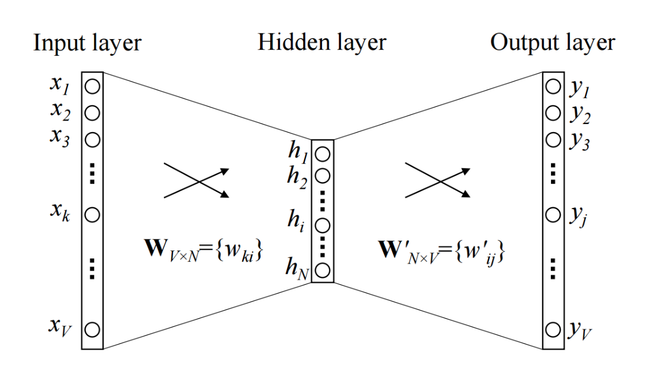
Word2Vec
The drawback of the classical approach is that the context is lost.
Solution: word embedding
It is capable of capturing context of a word in a document, semantic and syntactic similarity, relation with other words, etc.
Word2vec is an unsupervised model that learns word embedding from raw text.
Word2Vec builds on the fact that words that share similar contexts also share semantic meanings.
Word2vec model predicts a word by using its neighbors, by learning dense vectors called embedding.

Slide 32



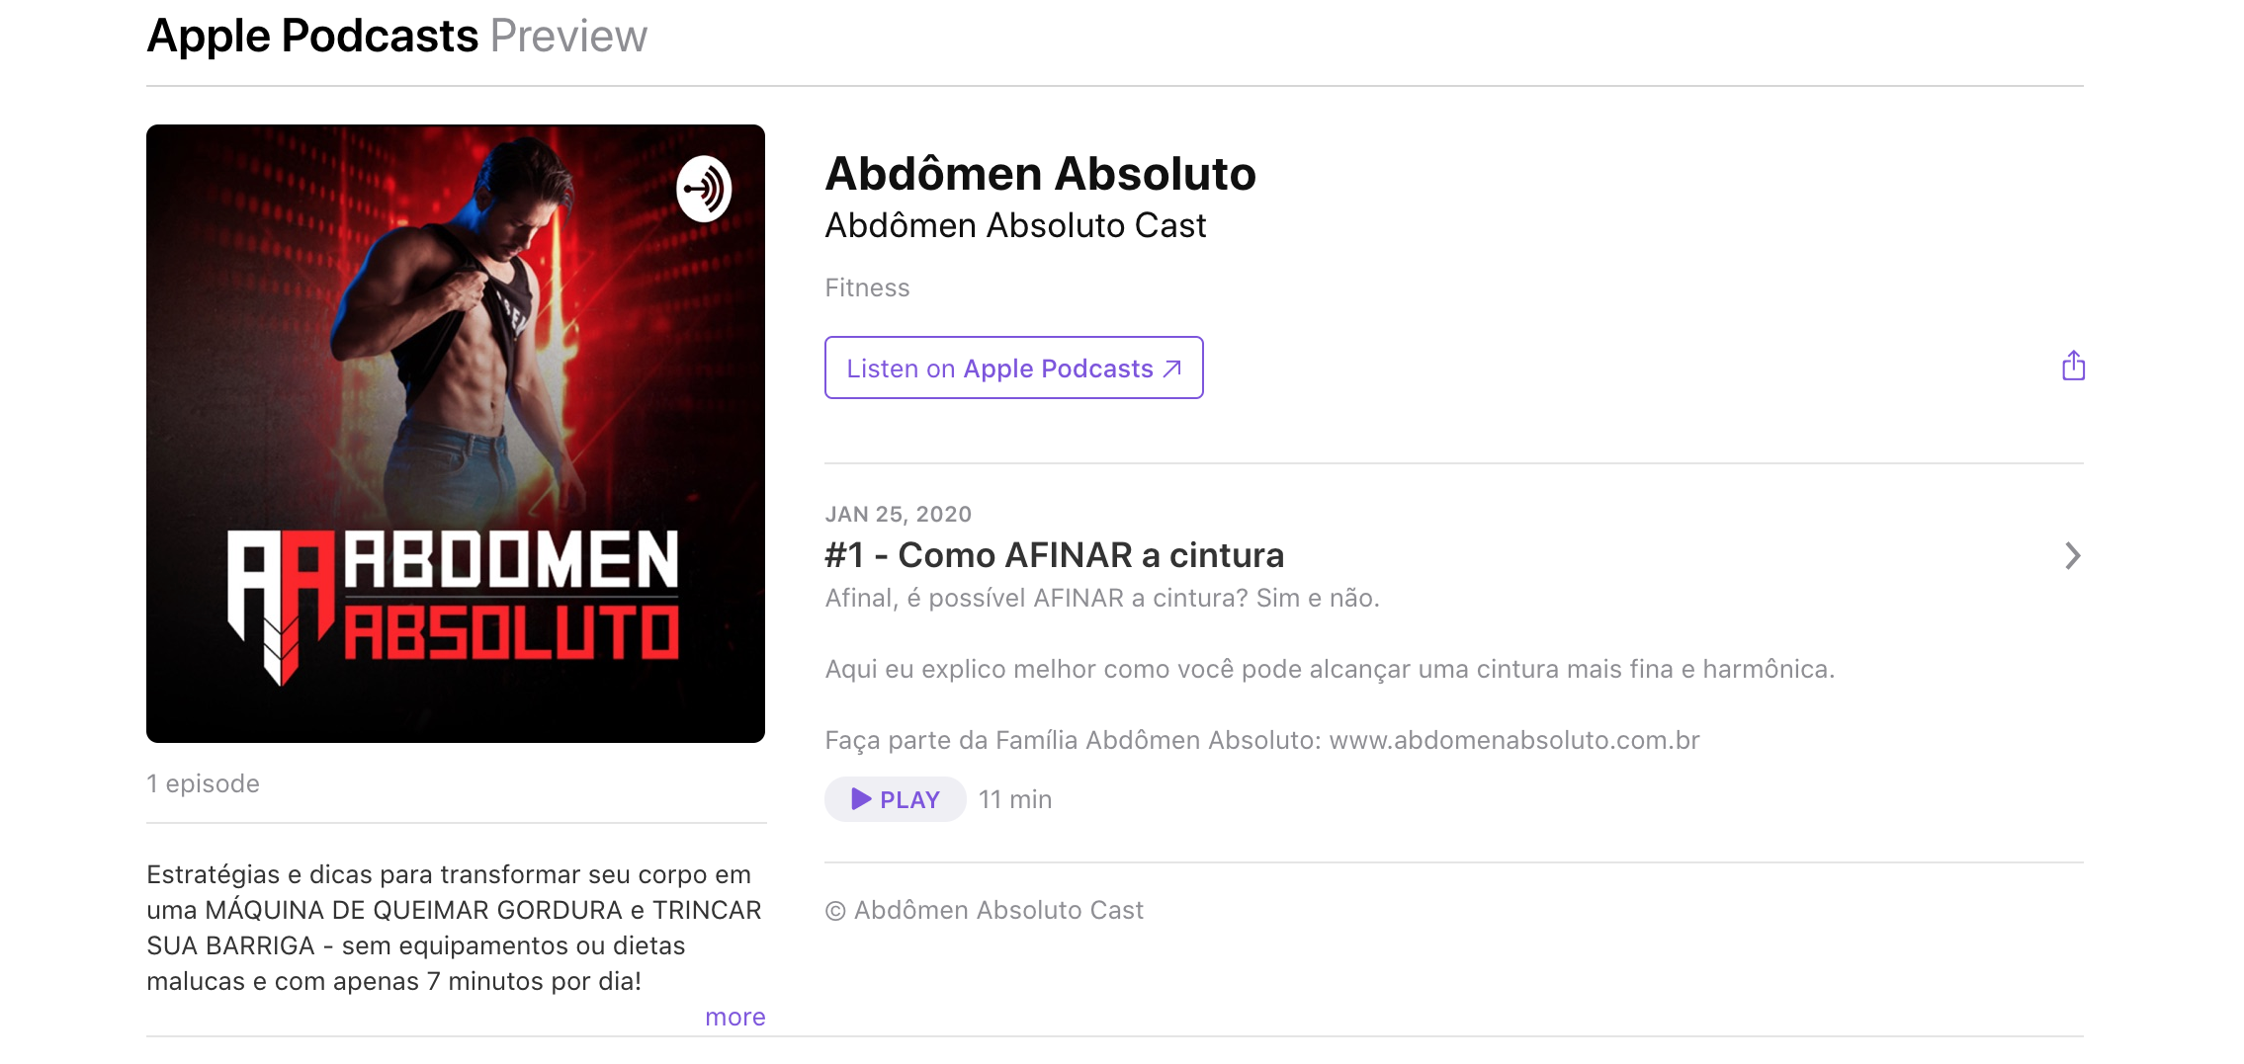
Problem
Among 10k fitness and health podcasts, 4115 podcasts have reviews
How to become an podcast influencer?
How to get higher popularity?
Notes:
why focus on the fitness
A lot of podcast doesn't have reviews
and even have reviews and ratings, will the ratings in the future, and how to improve the

Slide 33
Web app - input

Slide 34
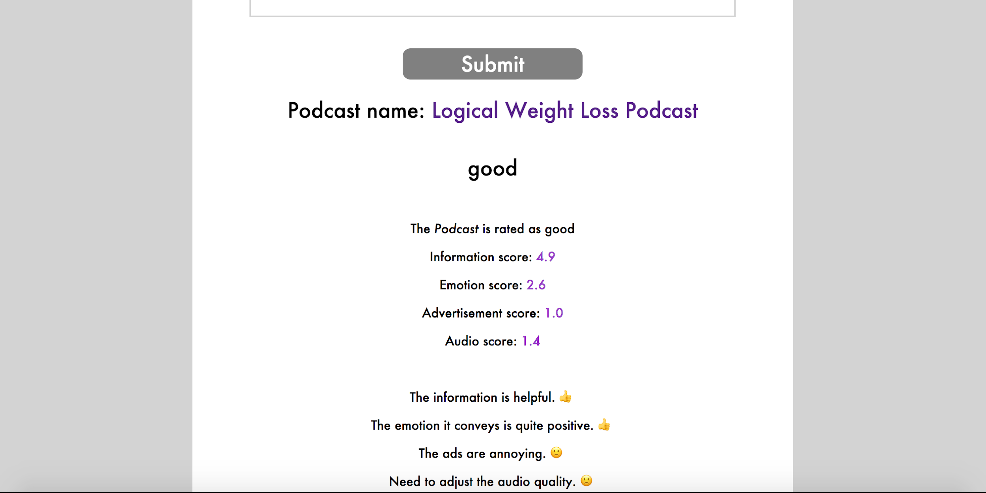
Web app - output

Slide 35
Data
Rating level
Low: 0 < average_rating <= 3.5
Fair: 3.5 < average_rating <= 4.9
Good: 4.9 < average_rating <= 5.0
Description
Review

Slide 36
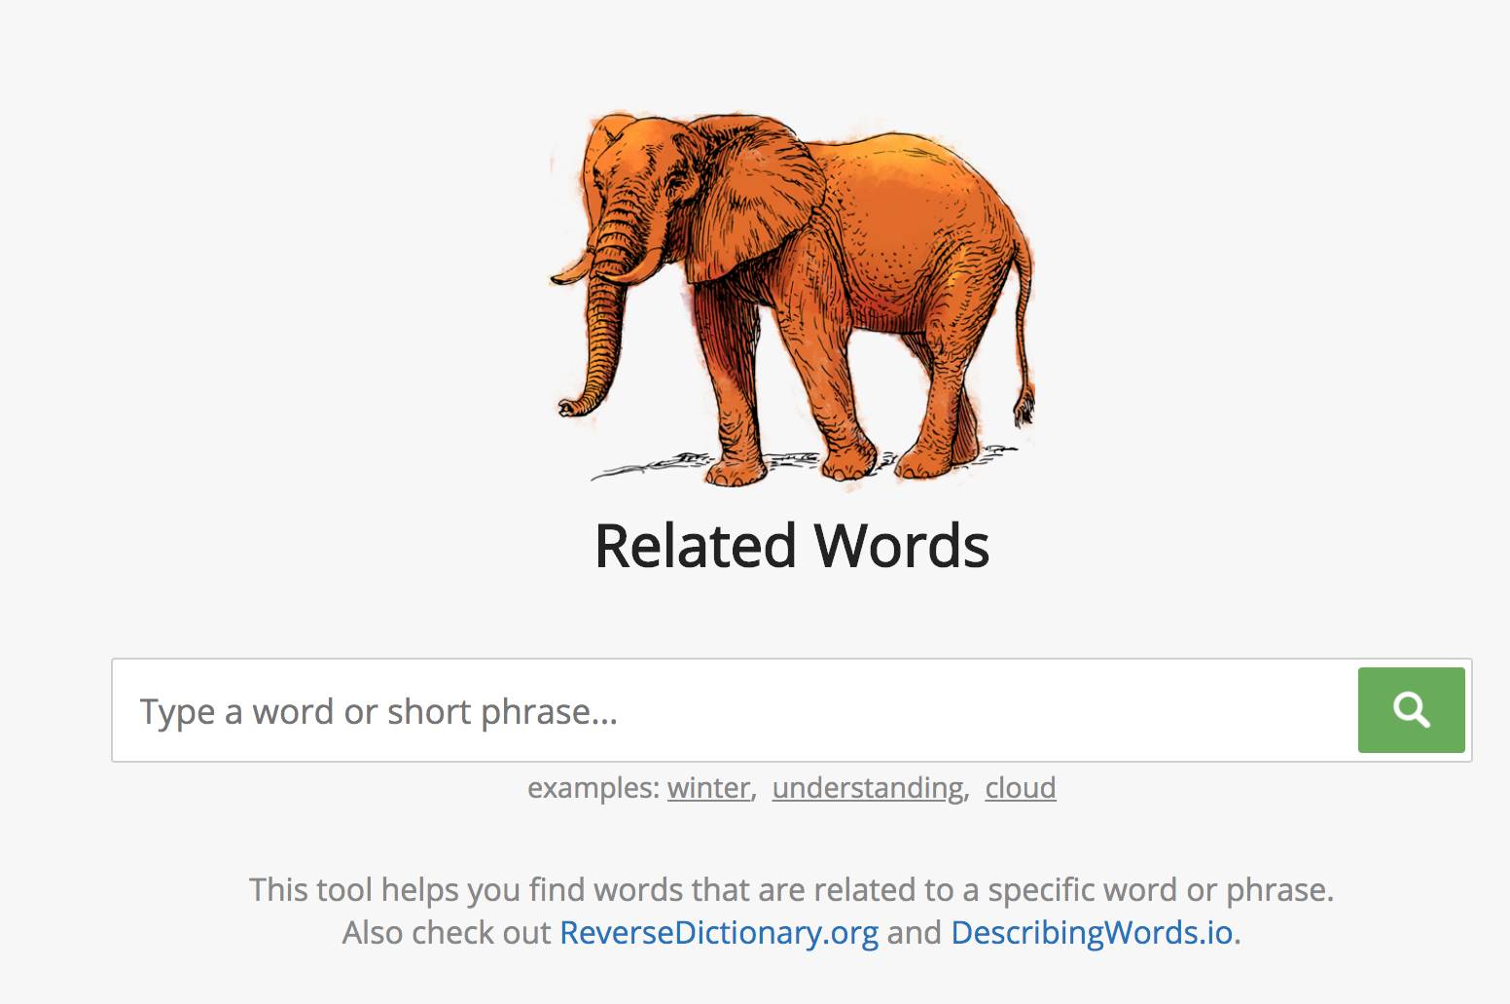
Data
knowledge
data
news
intelligence
insight
......
inspiring
feeling
delight
disappoint
unhappy
......
advertisement
promotion
sponsor
product
brochure
......
audio
sound
voice
acoustic
frequency
......
Information
Emotion
Advertisement
Audio
Review Categorization
Sentiment Analysis
Description Vectorization
Prediction
Notes:
I inspect the reviews, and find out that they could be categorized into four main categories, infromation, emotion, advertisement, audio
For each category, I used the related words website to find related words, this site uses pretrained word embedding to find related words.
topic modeling
no category related to fitness
what pretrained word embedding model, word2vec

Slide 37
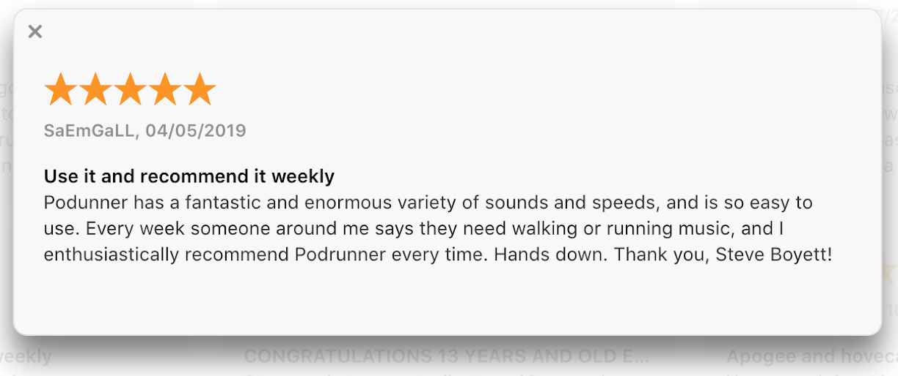
Data
knowledge
data
news
intelligence
insight
......
inspiring
feeling
delight
disappoint
unhappy
......
advertisement
promotion
sponsor
product
brochure
......
audio
sound
voice
acoustic
frequency
......
Information
Emotion
Advertisement
Audio
Review Categorization
Cosine Similarity
Sentiment Analysis
Information
Advertisement
Description Vectorization
Emotion
Audio
Prediction
Notes:
uses word embedding to convert words into many dimensional vectors which represent their meanings. The vectors of the words in your query are compared to a huge database of of pre-computed vectors to find similar words.
topic modeling
no category related to fitness
different color of each category, split ONE review into sentences

Slide 38
Data
[ Information, Emotion, Advertisement, Audio ]
Review Categorization
[ 1.67, 0, 0, 0 ]
Sentiment Analysis
[ 1.67, 1.58, 0, 0 ]
Description Vectorization
[ 1.67, 1.58, -0.70, 0 ]
Prediction
[ 1.67, 1.58, -0.70, 0.90 ]
Notes:
present real scores

Slide 39
Data
[ Information, Emotion, Advertisement, Audio ]
Review Categorization
"Very informative. Gained some new insights that will help me take my workout to the next level."
[ 1.67, 0, 0, 0 ]
Sentiment Analysis
"Amazing podcast! Makes me so motivated!"
[ 1.67, 1.58, 0, 0 ]
Description Vectorization
"The advertisements are annoying, they interrupt already brief podcasts"
[ 1.67, 1.58, -0.70, 0 ]
Prediction
"Podunner has a fantastic and enormous variety of sounds and speeds"
[ 1.67, 1.58, -0.70, 0.90 ]
Notes:
present real scores

Slide 40
Data
[ Information, Emotion, Advertisement, Audio ]
Review Categorization
"Very informative and gained some new insights that will help me take my workout to the next level."
[ 1.67, 0, 0, 0 ]
Sentiment Analysis
"Makes me so motivated!"
[ 1.67, 1.58, 0, 0 ]
"But the advertisements are annoying, they interrupt already brief podcasts."
Description Vectorization
[ 1.67, 1.58, -0.70, 0 ]
"It has a fantastic and enormous variety of sounds and speeds."
Prediction
[ 1.67, 1.58, -0.70, 0.90 ]
Notes:
Here are the splitted sentences from the last review, For each sentence, after categorized into one of the 4 categories, I used the vaderSentiment to provide sentiment score for each sentence which forms the sentiment vector
bolld the sentence, replace the information emotion witht the score, this is positive score, this is negative score
assign each sentence the sentiment score

Slide 41
Data
[ Information, Emotion, Advertisement, Audio ]
Review Categorization
"Very informative and gained some new insights that will help me take my workout to the next level."
[ 1.67, Emotion, Advertisement, Audio ]
Sentiment Analysis
"Makes me so motivated!"
[ 1.67, 1.58, Advertisement, Audio]
"But the advertisements are annoying, they interrupt already brief podcasts."
Description Vectorization
[ 1.67, 1.58, -0.70, Audio ]
"It has a fantastic and enormous variety of sounds and speeds."
Prediction
[ 1.67, 1.58, -0.70, 0.90 ]
Notes:
Here are the splitted sentences from the last review, For each sentence, after categorized into one of the 4 categories, I used the vaderSentiment to provide sentiment score for each sentence which forms the sentiment vector
bolld the sentence, replace the information emotion witht the score, this is positive score, this is negative score
assign each sentence the sentiment score

Slide 42
Data
SVM classification
Train the weighted model on 2771 samples having > 2 reviews
Validate on the 1334 samples having <= 2 reviews
Accuracy 82%
Review Categorization
Sentiment Analysis
Vectorization
Prediction
Notes:
Go back to the problem, most examples have few reviews, To prove this model works for samples with few reviews

Slide 43
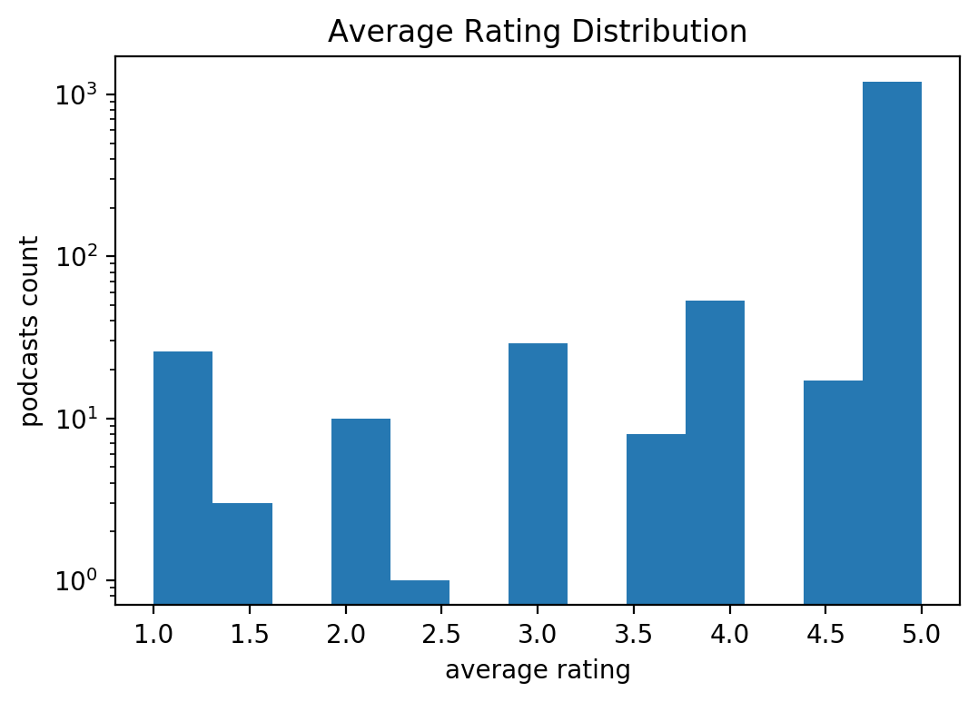
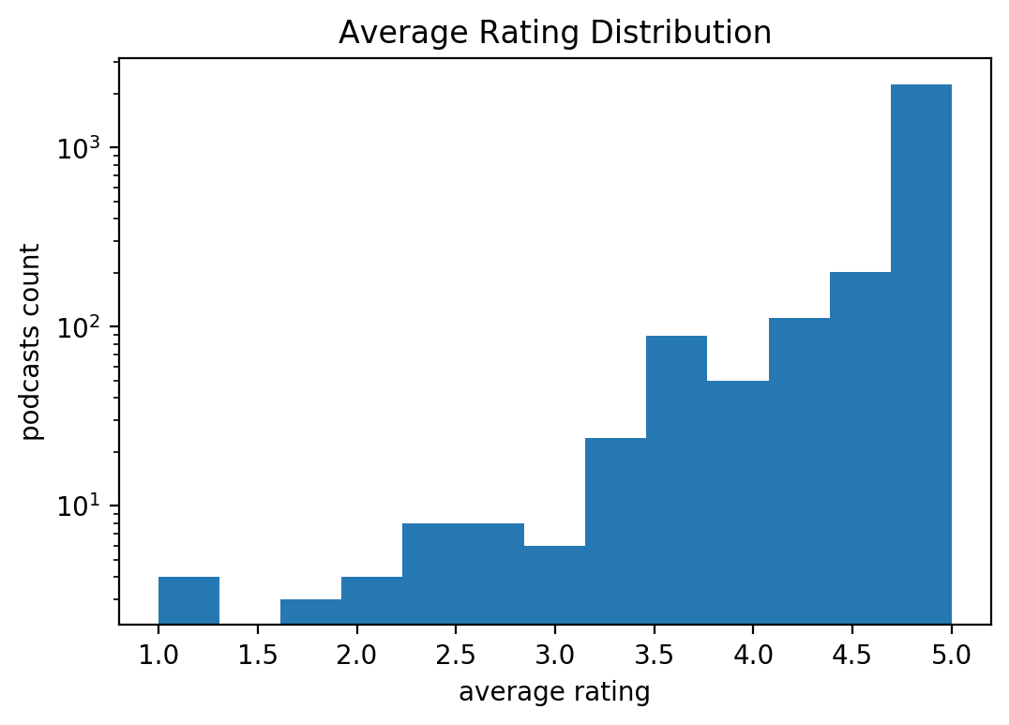
Data
SVM classification
Train on samples that have > 2 reviews
Validate on samples that have <= 2 reviews
Review Categorization
Low rating level mainly distributes within the samples with <= 2 reviews
Sentiment Analysis
Vectorization
Prediction
Notes:
The reason leads to the low prediction rate of the low rating level is that, Low rating level mainly distributes within the samples with <= 2 reviews

Slide 44
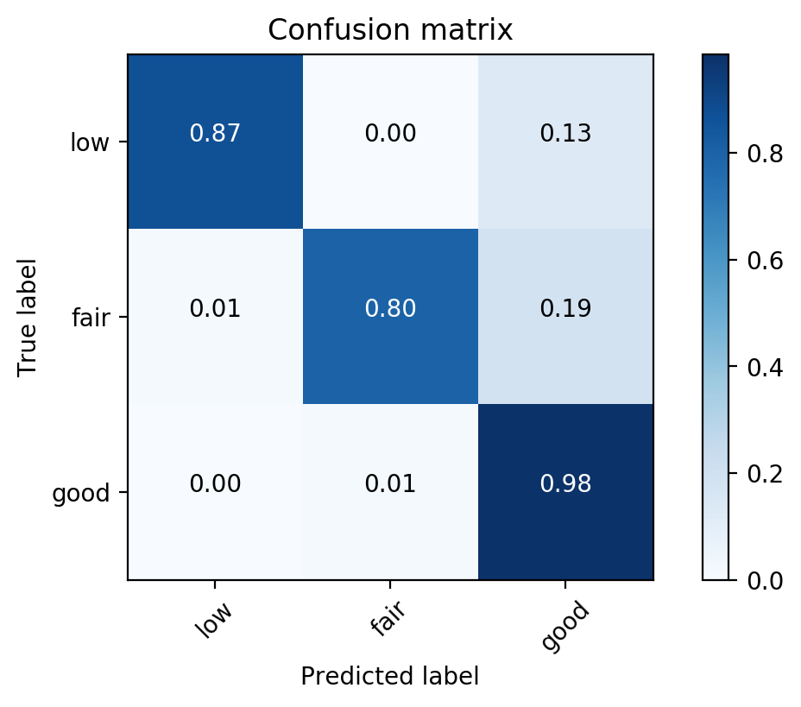
Data
SVM classification
Validate model on the samples having <= 2 reviews
Review Categorization
Sentiment Analysis
Vectorization
Prediction
Notes:
Go back to the problem, most examples have few reviews, To prove this model works for samples with few reviews

Slide 45

Data
Rating level
Low: 0 < average_rating <= 3.5 (136 samples)
Fair: 3.5 < average_rating <= 4.8 (658 samples)
Good: 4.8 < average_rating <= 5.0 (3321 samples)
Notes:
Due to the skewed dataset, I recategorize the average ratings into low, fair, good, these three levels.
Here in this project, I categorize the average ratings into three levels, low fair and good. The reason is that normally, if people don't like the podcast or the podcast has serious problems, the ratings are tends to be as low as 1 to 2. If they like it, they are normally be rated to be 4 to 5 stars. So if the rating is about 3-4, they have the potential to improve.
histogram

Slide 46
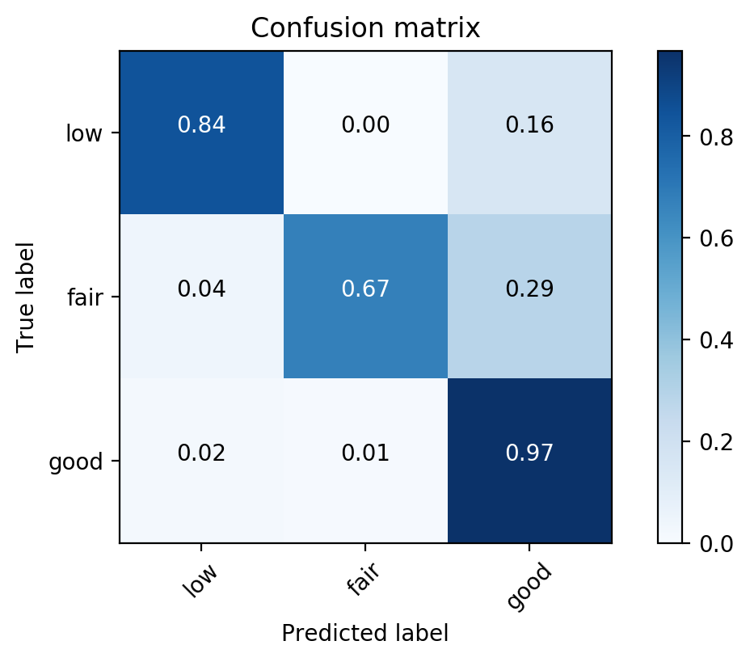
Train on train set validate on less2

Slide 47
Train on over2, validate on less2
Train on train set, validate on test less2
Train on train set, validate on less2

